Slide 1
Recipe redux
By: Devin Rayfield
Advisor: Mitchell Neilsen

Slide 2
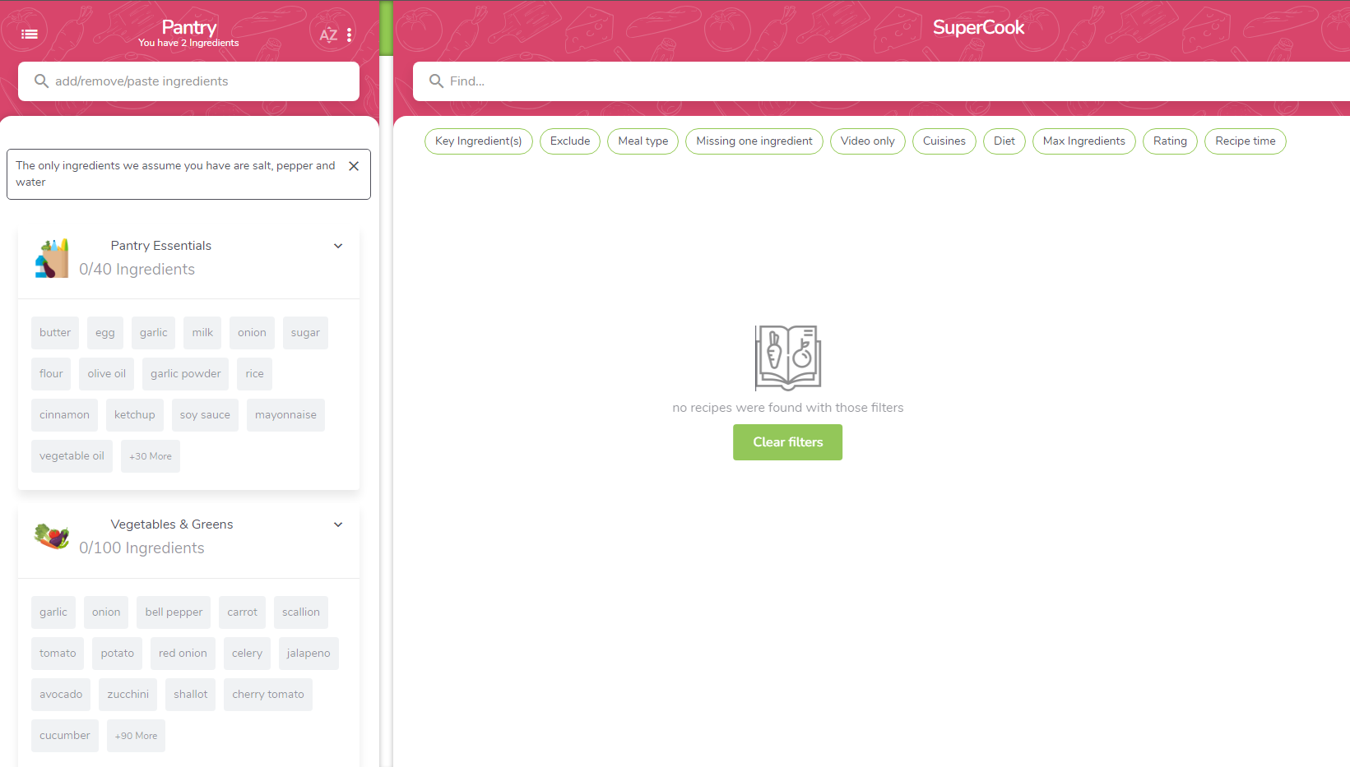
introduction
Why this project?
What is it?
Inspiration:
Supercook

Slide 3
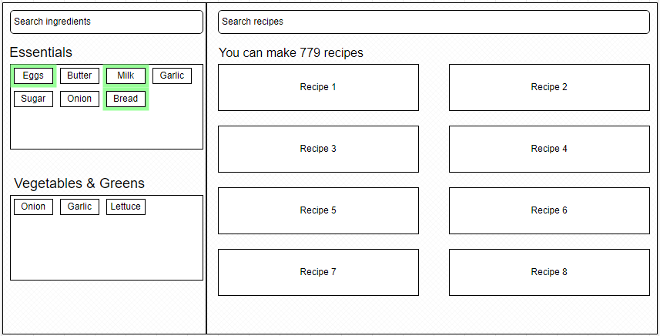
Design

Slide 4
MVP
Ingredient Selection
Basic Recipe Display
User Authentication

Slide 5
USE cases
I. Create Account
Able to log in and select ingredients
Ingredients will be saved
II. Recipes
Ex. Bread, Egg, Milk shows French Toast Recipes
III. Pantry Updates
Selected ingredients added to pantry

Slide 6
Version 1.0
Recipe Filtering
Grocery List
Additional Information (nutritional)
Interactive Pantry

Slide 7
Version 2.0
User Profile Management
Export Recipes
Social Sharing

Slide 8





implementation

Slide 9
Timeline
March 25:
Decided New Topic
April 16:
MVP Complete
April 30:
V1.0 Finished
March 27-29:
Resubmit Design Documents/
First Presentation
April 17:
Second Presentation
Finals Week:
Final Presentation/Get as much of
v2.0 done as possible

Slide 10
Questions?

